Slide 1
Domain-Indexing Variational Bayes:
Interpretable Domain Index for Domain Adaptation
Zihao Xu*, Guang-Yuan Hao*, Hao He, Hao Wang
*These authors contributed equally to this work.
Notes:
Hi, everyone, this is Zihao Xu. Today I am going to present our work: Domain-Indexing Variational Bayes: Interpretable Domain Index for Domain Adaptation. This is a joint work with Guang-yuan Hao, Hao He and Hao Wang.

Slide 2
Background
Domain Adaptation
Multiple Source Domains
Multiple Target Domains
predict $Y_{t}$
$X_{s}$ and $Y_{s}$
$$X_{t}$$
Notes:
Domain adaptation mainly address the cross-domain generalization problems in machine learning models. Typically, we will assume that in the source domains, we have source data x_s and source labels y_s. In target domains, we only have target data x_t.
Our goal is to predict target labels y_t within target domains.

Slide 3
Background
Domain index
Using domain indices boosts Domain Adaptation performance [1][2].
[1] Hao Wang, Hao He, and Dina Katabi. Continuously indexed domain adaptation. In ICML, 2020.
[2] Zihao Xu, Guang-He Lee, Yuyang Wang, Hao Wang, et al. Graph-relational domain adaptation. In ICLR, 2022.
Notes:
Recent studies have shown that, using domain indices can significantly boost the domain adaptation performance. To fully appreciate the magic of domain indices, we should first understand, what are domain indices?

Slide 4
Background
What is a domain index?
Domain index
A real-value scalar (vector)
Uniquely identify a domain
Represent domain semantics
Notes:
In general, a domain index must meet the following requirements:
First, it is a real-value scalar or vector.
Second, it must uniquely identify a domain. Different domains should have different domain indices.
And finally, it should represent the domain semantics, much like a word embedding. The distance between different domain indices should indicate the relationship of different domains.
（1分21秒)

Slide 5
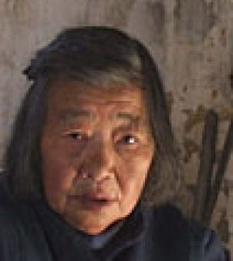
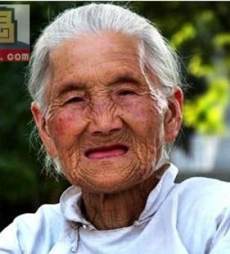
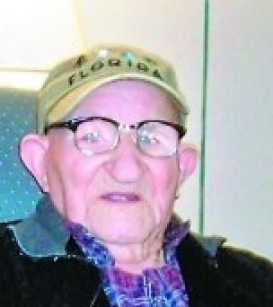
Background
Example for domain indices
Example: Gender Classification
Use average age as domain indices
Domain 3
Domain 4
Domain 1
Domain 2
74
80
19
25
Source Domains: Young
Target Domains: Old
Exploiting effective facial patches for robust gender recognition. Tsinghua Science and Technology. 2019
Notes:
To illustrate the concept of domain indices, let’s consider a gender classification task. In this task, we aim to classify gender based on face shots. We have 2 source domains, which mainly consist of young people, and 2 target domains, which mainly consists of older people.
In this case, we can use the average age as the domain index. It satisfies all the requirements of a domain index: it is a real-value scalar, uniquely identifies a domain, and represents domain semantics.

Slide 6
Background
Example for using domain indices
Continuously indexed domain adaptation
Encoder E
Predictor F
Data $x$
E
$$z$$
F
Predicted label $y′$
Domain indices $β$
D
Predicted domain indices $β′$
Enforce $β\text{⫫}z$
Discriminator D
Continuously indexed domain adaptation, ICML 2020
Notes:
We further demonstrate how to use domain index to improve domain adaptation. I will take Continuously indexed domain adaptation as an example. It mainly uses domain indices in 2 key areas:
First, it takes domain indices as the input of the encoder.
Second, the discriminator and the encoder play a min-max game centered on the domain indices. The discriminator tries to predict the domain indices beta based on the middle feature z, while the encoder tries to fool the discriminator by removing all domain-related information in the feature.
This min-max game enforces the independence between the domain indices and the feature, which makes feature domain-invariant, and thus improve the domain adaptation performance.
（3分00秒）

Slide 7
Background
Challenge for using domain indices
Domain Indices may not be available!
Can we infer the domain indices from data?
Yes!
Notes:
So far, we have explored how to use domain indices in domain adaptation. However, there is a challenge:
domain indices may not be available. This severely limits the application of such indexed domain adaptation method.
A natural question is motivated: can we infer the domain indices directly from data?
And the answer is, yes!

Slide 8
Method
Advantages of inferring domain indices
Improve interpretability of domain adaptation
Improve performance of domain adaptation
Notes:
There are 2 major advantages of inferring the domain index:
First, it improves the interpretability of domain adaptation. This is because domain indices can shed light on the domain relationship. Domains with similar domain indices are more likely to share similar data distribution.
Second, it can also improve the performance of domain adaptation. By identifying the domain relationships, the model can better adapt itself to unseen domains, resulting in overall performance improvement.

Slide 9
Method
How to infer the domain indices?
Our solution:
1. Rigorously define domain indices.
2. Based on our definition, use Probabilistic Graphical Model (PGM) to infer the domain indices.
Notes:
We have already discussed the advantages of inferring domain indices. The next question is, how to infer the domain indices?
We propose our solution here, which can be divided into two steps:
First, we will rigorously define, what is the domain index.
And second, based on our definition, we will use Probabilistic Graphical Model (PGM) to infer the domain indices.

Slide 10
Method
How to infer the domain indices?
Our solution:
1. Rigorously define domain indices.
2. Based on our definition, use Probabilistic Graphical Model (PGM) to infer the domain indices.
Notes:
Let’s first explore the definition.

Slide 11
Method
Definition
Domain index definition (informal)
Independence: independent of the data's encoding $z$
Information Preservation: retain as much information on the data $x$ as possible.
Label Sensitivity: maximize adaptation performance.
Notes:
We list the definition as follows：
First, a domain index should be independent of the data’s encoding z.
Second, it must retain as much information on the data x as possible.
Finally, it should maximize the adaptation performance.
We summarize the 3 requirements as: Independence, Information Preservation and Label Sensitivity.
（4分49秒）

Slide 12
Method
How to infer the domain indices?
Our solution:
1. Rigorously define domain indices.
2. Based on our definition, use Probabilistic Graphical Model (PGM) to infer the domain indices.
Notes:
With the rigorous definition of domain indices, the next step is to infer the domain indices with PGM.

Slide 13
Method
PGM for inferring domain indices
$$N$$
$$α$$
x$x$
$α$: prior of the domain index, $k$: domain ID
Notes:
The generation process of our PGM can be characterized as follows: Suppose we have N domains in total.

Slide 14
Method
PGM for inferring domain indices
$$N$$
$$α$$
$$β_{k}$$
x$x$
x$x$
$β_{k}$: global domain indices (one instance per domain)
$α$: prior of the domain index, $k$: domain ID
Notes:
First, we will use the prior to generate global domain indices. This is one-per domain. Here k refers to the domain ID.

Slide 15
Method
PGM for inferring domain indices
$$N$$
$u$: local domain indices (one instance per datum)
$$α$$
$$β_{k}$$
$$u$$
$$D_{k}$$
x$x$
x$x$
x$x$
$β_{k}$: global domain indices (one instance per domain)
$α$: prior of the domain index, $k$: domain ID
Notes:
Next, using the global domain indices, we generate local domain indices, which is one-per datum. Suppose in domain K, we have D_k datapoints, then we will have D_k local domain indices

Slide 16
Method
PGM for inferring domain indices
$$N$$
$$α$$
$$β_{k}$$
$$u$$
$$D_{k}$$
x$x$
x$x$
x$x$
$$x$$
$x$: observed data (e.g., an image)
$α$: prior of the domain index, $k$: domain ID,
$β_{k}$: global domain indices (one instance per domain),
$u$: local domain indices (one instance per datum)
Notes:
We then use these local domain indices to generate the observed data, such as an image.

Slide 17
Method
Intuition behind global/local domain indices
$$β_{k}$$
$$u$$
x$x$
x$x$
$$x$$
Age: 24.7
Age: 25.4
Average Age: 25.0
Age: 25.1
Age: 24.8
Global Domain Indices (One per domain)
Local Domain Indices (One per datum)
Observed data
Notes:
To provide some intuition about this generation process, I will take the gender classification task as the example again.
We begin by generating the global domain indices, such as the average age.
Then, we produce the local domain indices, which is the age for each face shot.
Based on these ages, we generate the observed data. The reason for using this hierarchical structure is that, it can significantly boost the learning efficiency.
（5分58秒）

Slide 18
Method
PGM for inferring domain indices
$z$: domain-invariant data embeddings, $z\text{⫫}β$
$$N$$
$$z$$
x$x$
$$α$$
$$β_{k}$$
$$u$$
$$D_{k}$$
x$x$
x$x$
x$x$
$$x$$
$α$: prior of the domain index, $k$: domain ID,
$β_{k}$: global domain indices (one instance per domain),
$u$: local domain indices (one instance per datum),
$x$: observed data
Notes:
With the global and local domain indices, as well as the observed data, we proceed to generate the feature embedding z, which is domain-invariant. Note that the dash line here means beta and z should be independent.

Slide 19
Method
PGM for inferring domain indices
$y$: labels
$$N$$
$$z$$
x$x$
$$y$$
$$α$$
$$β_{k}$$
$$u$$
$$D_{k}$$
x$x$
x$x$
x$x$
$$x$$
$α$: prior of domain index, $k$: domain ID,
$β_{k}$: global domain indices (one instance per domain),
$u$: local domain indices (one instance per datum),
$x$: observed data, $z$: domain-invariant data embeddings
Notes:
Finally, we generate the labels for the observed data based on the feature embedding.

Slide 20
Method
Inference model
$$N$$
$$N$$
$$z$$
$$z$$
x$x$
$$y$$
x$x$
$$α$$
$$β_{k}$$
$$u$$
$$D_{k}$$
$$D_{k}$$
$$u$$
$$β_{k}$$
x$x$
x$x$
x$x$
$$x$$
$$x$$
x$x$
x$x$
Generative model
Inference model
$α$: prior of domain index, $k$: domain ID,
$β_{k}$: global domain indices (one instance per domain),
$u$: local domain indices (one instance per datum),
$x$: observed data, $z$: domain-invariant data embeddings, $y$: labels
Notes:
We have also developed the inference model, shown in the right figure. Now, the generative model and the inference model together, constitute the complete framework.

Slide 21
Method
Variational domain-indexing (VDI)
$$N$$
$$N$$
$$z$$
$$z$$
x$x$
$$y$$
x$x$
$$α$$
$$β_{k}$$
$$u$$
$$D_{k}$$
$$D_{k}$$
$$u$$
$$β_{k}$$
x$x$
x$x$
x$x$
$$x$$
$$x$$
x$x$
x$x$
Maximize Evidence Lower Bound (ELBO):
Notes:
The PGM is now established, and the next step, is to optimize this model.
To achieve this, we will maximize the evidence lower bound, ELBO. (This would maximize the log likelihood of the observed data and labels.)
However, solely relying on the ELBO cannot produce the desired domain indices. Recall that,

Slide 22
Method
Definition
Recall: Domain index definition (informal)
Independence: independent of the data's encoding $z$
Information Preservation: retain as much information on the data $x$ as possible.
Label sensitivity: maximize adaptation performance.
Notes:
Our domain index requires itself to be independent of the data encoding z, which cannot be achieved by the ELBO alone.

Slide 23
Method
Adversarial loss
$$N$$
$$N$$
$$z$$
$$z$$
x$x$
$$y$$
x$x$
$$α$$
$$β_{k}$$
$$u$$
$$D_{k}$$
$$D_{k}$$
$$u$$
$$β_{k}$$
x$x$
x$x$
x$x$
$$x$$
$$x$$
x$x$
x$x$
Adversarial loss: enforce $β\text{⫫}z$ (Independence)
Notes:
Therefore, we incorporate an adversarial loss to ensure that beta and z are independent with each other.

Slide 24
Method
Final objective function
$$N$$
$$N$$
$$z$$
$$z$$
x$x$
$$y$$
x$x$
$$α$$
$$β_{k}$$
$$u$$
$$D_{k}$$
$$D_{k}$$
$$u$$
$$β_{k}$$
x$x$
x$x$
x$x$
$$x$$
$$x$$
x$x$
x$x$
ELBO
Adversarial loss
Notes:
Our final objective function combines the previous 2 loss: the ELBO and the adversarial loss.
（7分24秒）

Slide 25
Theory
Theorem (informal)
Using this objective function, we could learn domain indices $β$ according to the previous definition.
Independence
Information Preservation
Label sensitivity
Notes:
We have proved that,
by using this objective function, we could learn domain indices beta according to the previous definition.
Specifically, the inferred domain indices will satisfy Independence, Information preservation and label sensitivity.

Slide 26
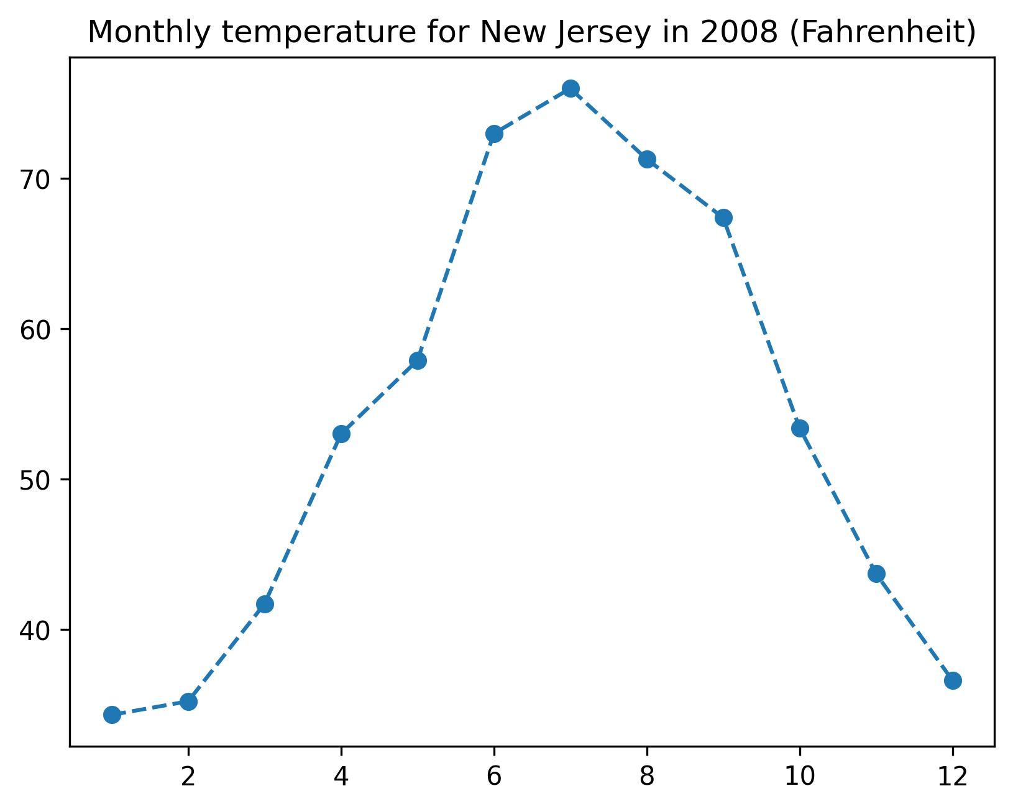
Experiment
TPT-48
Input
Prediction
Task: temperature prediction
N (24) $→$ S (24)
Notes:
The experiment results also demonstrate the effectiveness of our model. We will use experiments on TPT-48 as an example. TPT-48 is a real-world dataset that contains monthly average temperature for the 48 contiguous states in the US. On this dataset, we will focus on transferring the temperature prediction model. One of our domain adaptation tasks is formulated as:
North (24) to South (24), which is adapting models from 24 states in the north to 24 states in the south.
We also divide the target domains into 3 levels to report fine-grained results.
（8分22秒）

Slide 27
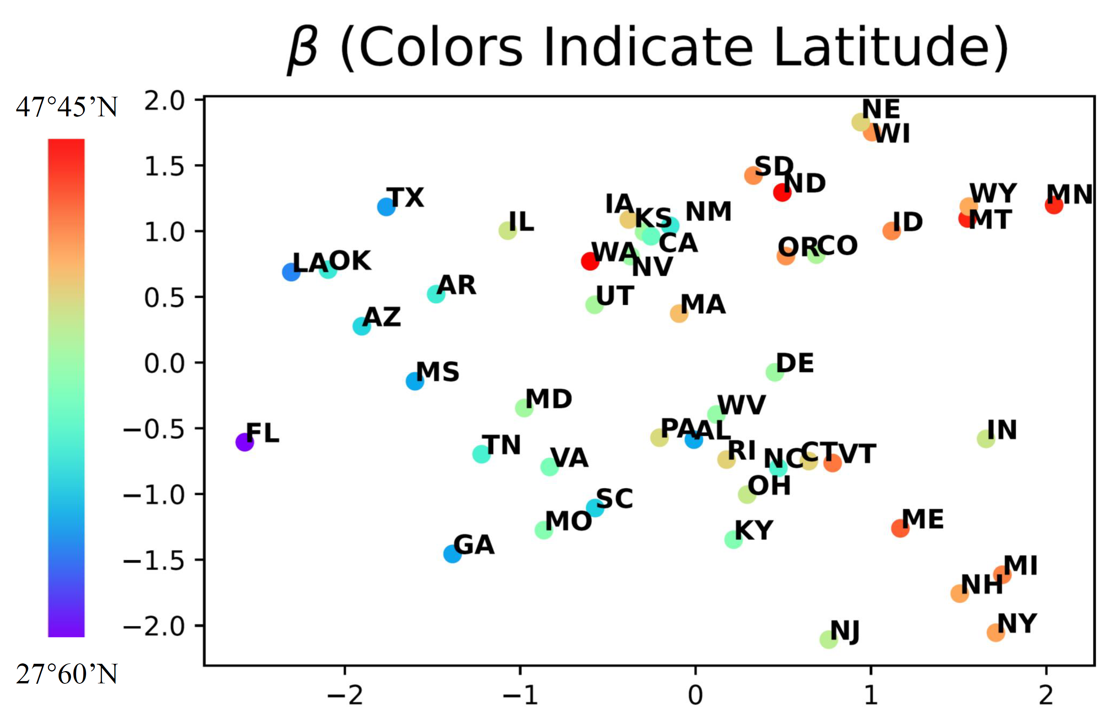
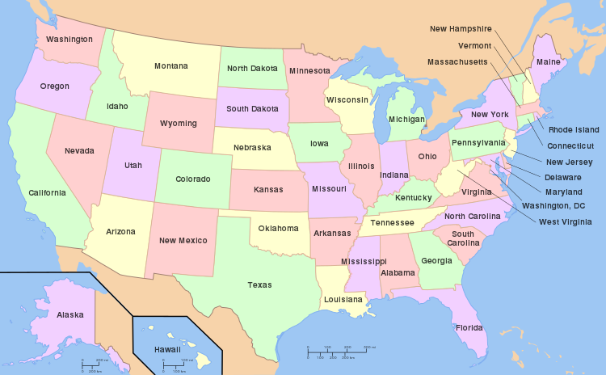
Experiment
Domain index visualization
Notes:
Let’s first see the visualization of inferred domain indices. Here, the colors indicate each state’s latitude.
We observe that, when 2 states have similar latitude, their domain indices are also close along the x-dimension, such as the New York and the New Jersey.

Slide 28
Experiment
Domain index visualization
No latitude input!
Notes:
In contrast, when 2 states’ latitude are quite distinct from each other, their domain indices are further apart on the x-dimension, as seen from the Florida and the New Jersey.
In fact, a correlation can be drawn between the latitude and the x-dimension of the domain indices. This is reasonable, because temperature is highly corelated with the latitude of the state.
Notice that, we never use latitude information as input. This means our model truly learns useful domain indices during the adaptation.

Slide 29
Experiment
Performance of VDI
TPT-48:
Notes:
We also report numerical results on this task.
Our model achieves superior performance in both overall evaluation and finer-grained evaluations.

Slide 30
Conclusion
Take home message:
VDI provides a principled way to infer the domain index.
VDI improves both interpretability and performance of domain adaptation.
VDI has theoretical guarantee.
Notes:
To summarize, our take home messages are as follows:
VDI provides a principled way to infer domain index.
VDI improves both interpretability and performance of domain adaptation.
VDI has theoretical guarantee.

Slide 31
Supplement
Code
Paper
https://github.com/Wang-ML-Lab/VDI
https://arxiv.org/abs/2302.02561
Notes:
For more information about our work, please refer to our paper and our source code.
Thank you!

Slide 32
Thank you!
Q & A

Slide 33
Conclusion
Take home message:
VDI provides a principled way to infer domain index.
VDI improves both interpretability and performance of domain adaptation.
VDI has theoretical guarantee.
Notes:
Take home message:
VDI provides a way to infer domain index, improve performance, and have theortical guarantee

Slide 34
Method
PGM for inferring domain indices
$$N$$
$$α$$
$$β_{k}$$
$$u$$
$$D_{k}$$
x$x$
x$x$
x$x$
$α$: prior of domain index, $k$: domain ID,
$β_{k}$: global domain index (one instance per domain),
$u$: local domain index (one instance per datum)
Notes:
Left: graphic model of VDI, inferring domain index during adaptation; right: the variational distribution that approximate the posterior of VDI. Dashed line. Shady color observed variable. No color means latent variable.

Slide 35
Thank you!
Reference
[1] Hao Wang, Hao He, and Dina Katabi. Continuously indexed domain adaptation. In ICML, 2020.
[2] Zihao Xu, Guang-He Lee, Yuyang Wang, Hao Wang, et al. Graph-relational domain adaptation. In ICLR, 2022.
Notes:
Take home message:
VDI provides a way to infer domain index, improve performance, and have theortical guarantee

Slide 36
Background
Domain Adaptation
Continuously Indexed Domain Adaptation (CIDA)
Encoder E
Predictor F
Data $x$
E
$$z$$
F
Predicted label $y′$
Domain index $β$
For $D$:
Minimize ${(D\left(z\right)−β)}^{2}$
D
Predicted domain index $β′$
For $E$, $F$:
Minimize $L\left(F\left(z\right),y\right)−{(D\left(z\right)−β)}^{2}$
Discriminator D
Notes:
Introduce 2nd concept: Domain index. Domain index refers to a scaler vector that embed domain semantics. For this example, we use the average age of each domain as the domain index. Recent paper found using domain index in DA training facilitate the DA performance. Banner: what you want to do with this slides, change \bete!

Slide 37
Method
Domain-Indexing Variational Bayes
Variational inference process
Evidence Lower Bound:
Notes:
\theta, \phi is the neural network parameters

Slide 38
Method
Domain-Indexing Variational Bayes
Variational inference process
Evidence Lower Bound:
Notes:
Every mu, sigma here is a non-linear function that with learnable parameters. Usually, we will use neural network to implement such function

Slide 39
Method
Domain-Indexing Variational Bayes
Variational inference process
Evidence Lower Bound:
Notes:
But Q(\beta | u) needs special treatment.

Slide 40
Method
Domain-Indexing Variational Bayes
Variational inference process
Infer $q_{φ}(β|u)$:
Notes:
But Q(\beta | u) needs special treatment.

Slide 41
Method
Domain-Indexing Variational Bayes
Variational inference process
Network Structure
Notes:
But Q(\beta | u) needs special treatment.

Slide 42
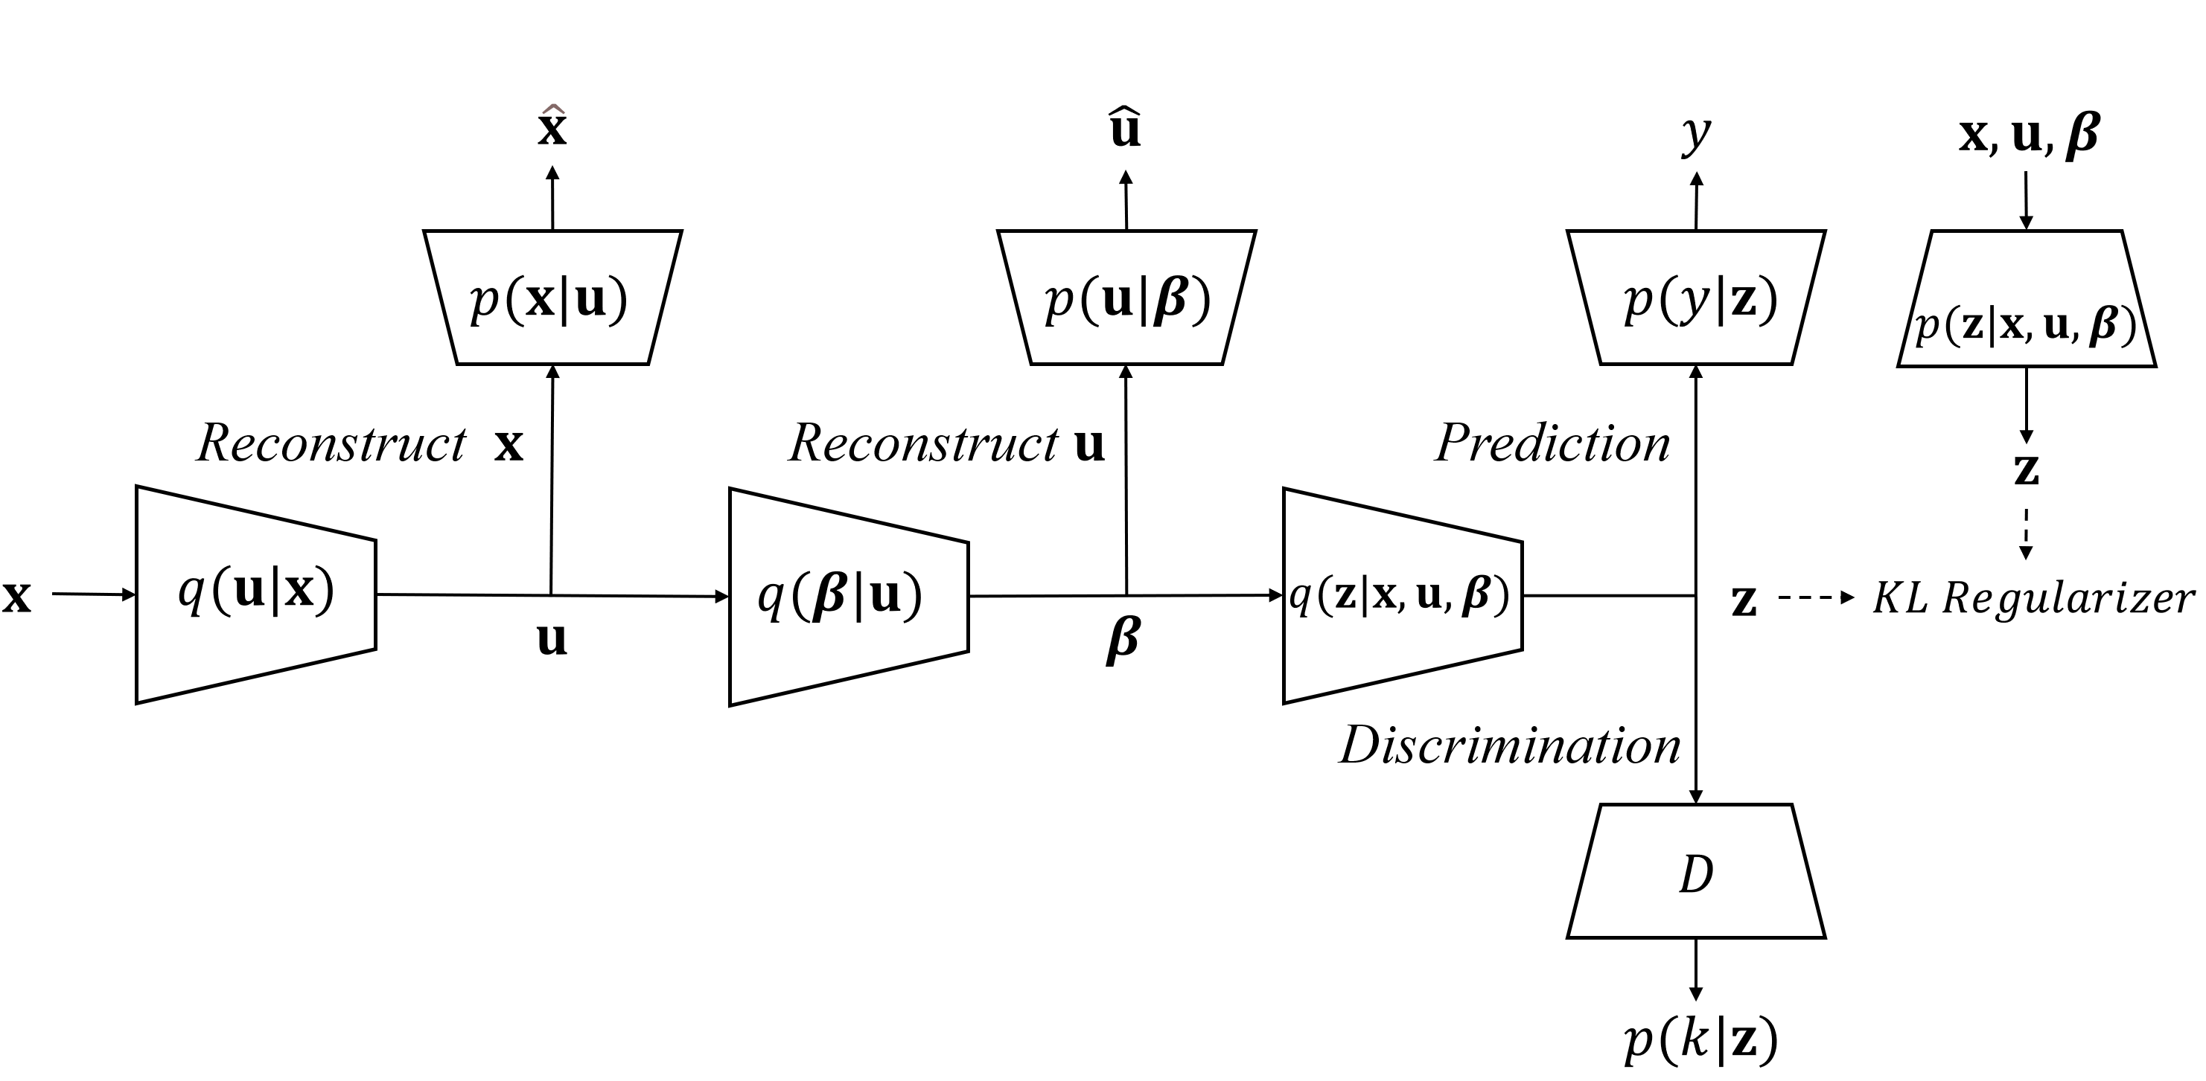
Method
Domain-Indexing Variational Bayes
Variational inference process
Network Structure (full)
Notes:
But Q(\beta | u) needs special treatment.

Slide 43
Method
Domain-Indexing Variational Bayes
Variational inference process
Model:
Input: data $x_{s}$, label $y_{s}$ on source domains, data $x_{t}$ on target domains
Output: label $y_{t}$ on target domains, domain index $β_{k}$
Maximize $log p(x_{s},y_{s})$ &$log p(x_{t})$.
Notes:
Before inferring domain index, we have to define what is exactly the domain index. Mathmatic characterization, or formal definition of domain index, refer to our paper
1，首先展示总体loss，一个是evidence lower bound，一个是adversarial training. 然后展开分项，并讲其中一项是需要特殊建模的earth moving distance
2，实验先放可视化，再放其余结果

Slide 44
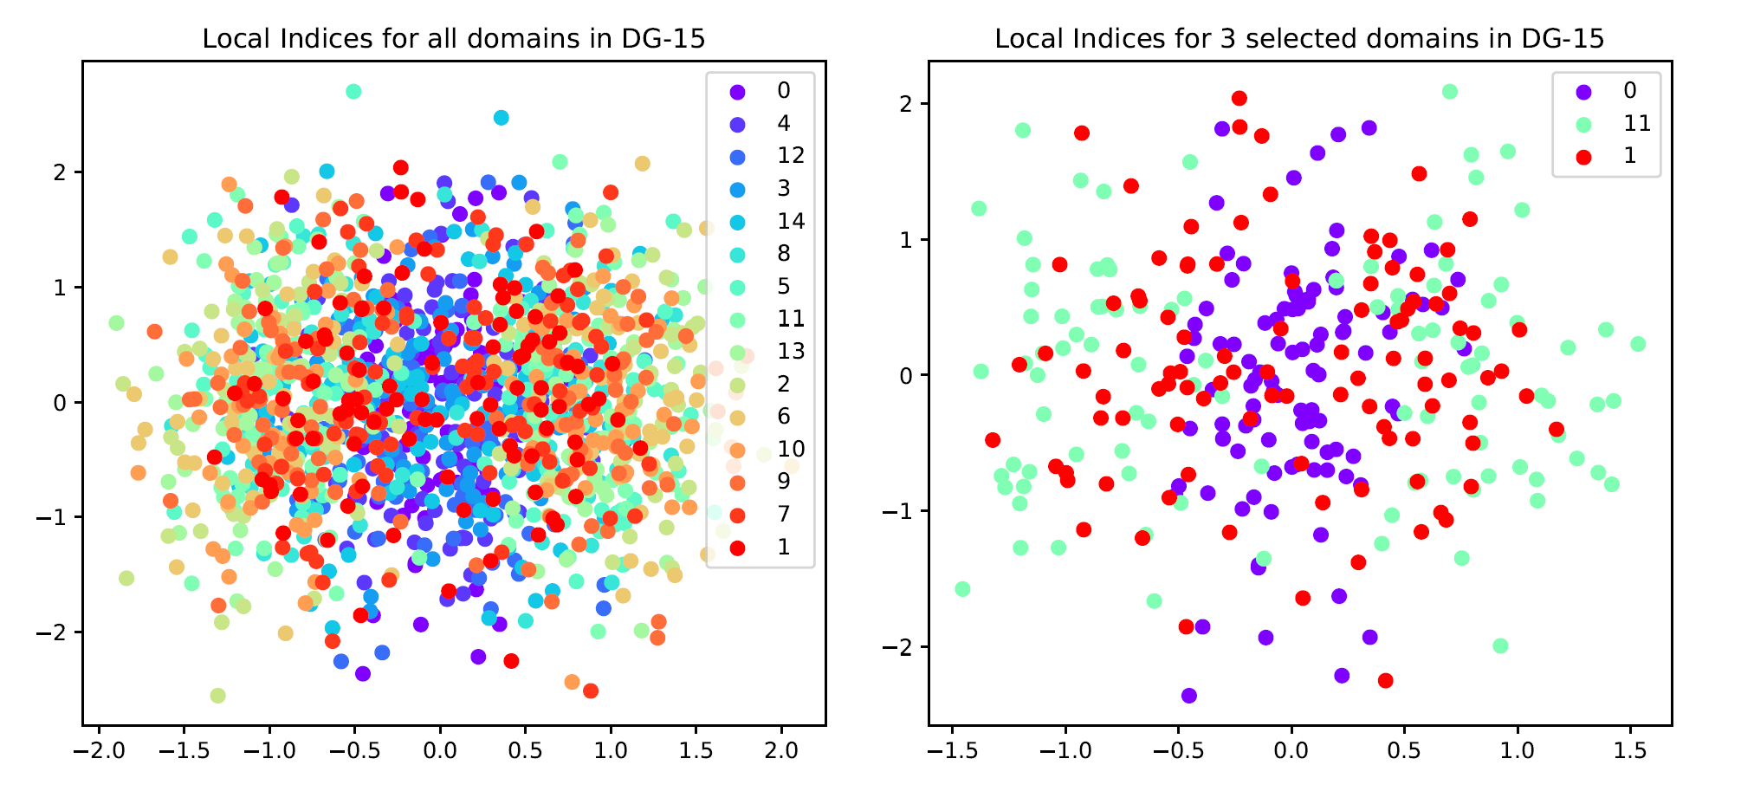
Method
Domain-Indexing Variational Bayes
Variational inference process
Pairwise Domain Distance: why Earth Moving Distance?
Observation: Average of Local Domain Indices may be close
Notes:
But Q(\beta | u) needs special treatment.

Slide 45
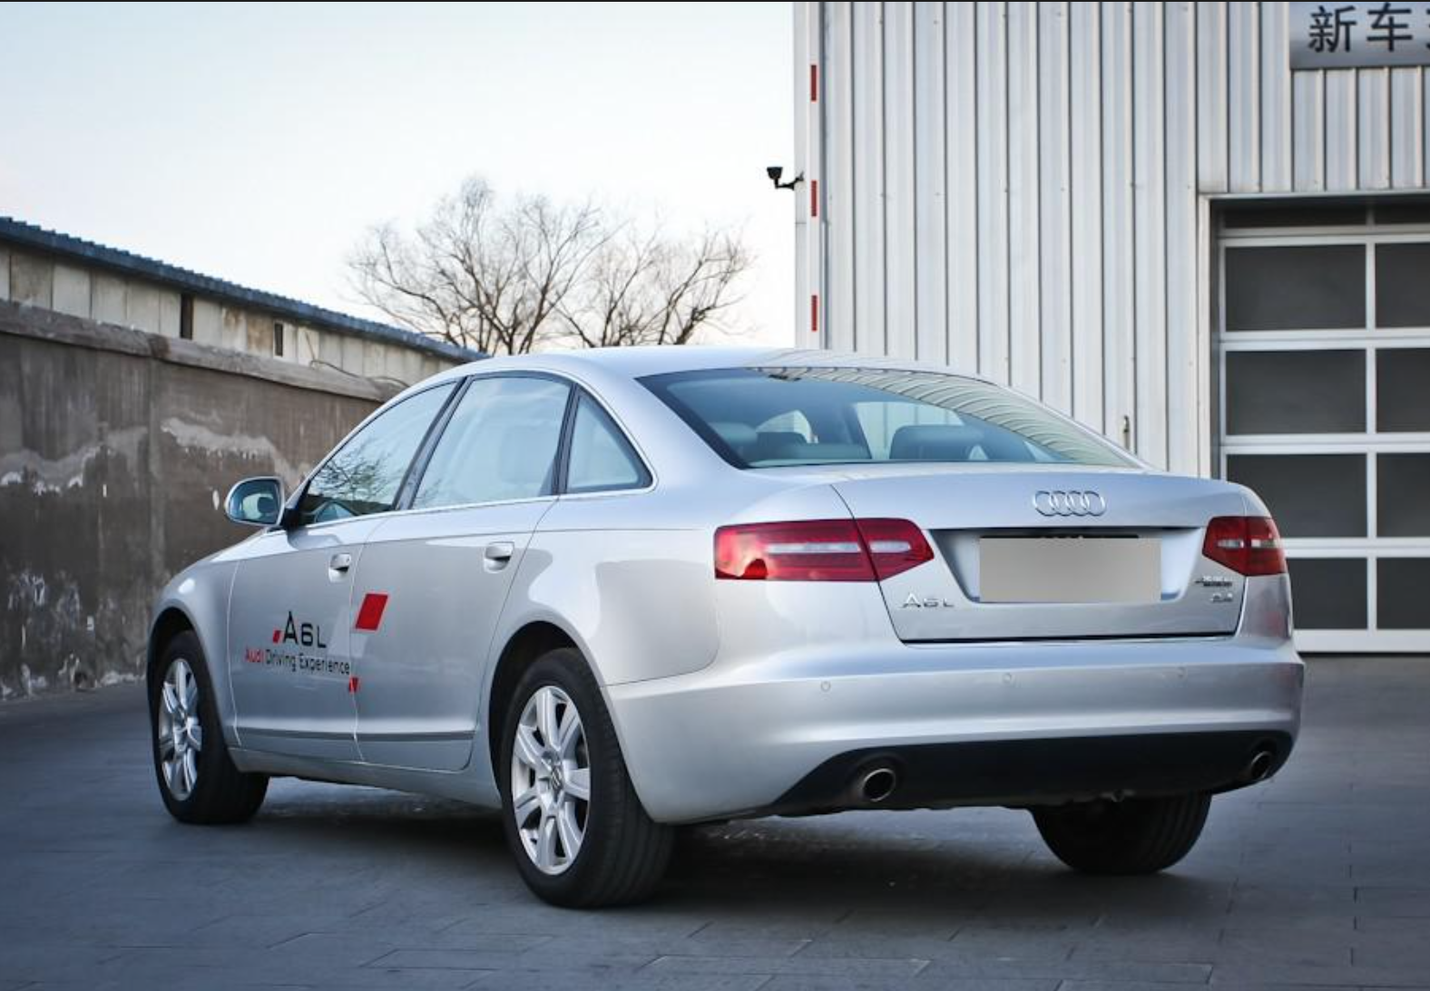
Method
Domain-Indexing Variational Bayes
Variational inference process
Why not directly infer global domain index?
Hard to optimize
Not Efficient
Infer $q_{φ}\left(β | u\right)$ v.s. Infer $q_{φ}\left(β | x\right)$
$u$ is low-dimensional compared to $x$
$$x:224×224×3$$
$$u:4$$
Notes:
Applying earth moving distance directly on x is very time-comsuming

Slide 46
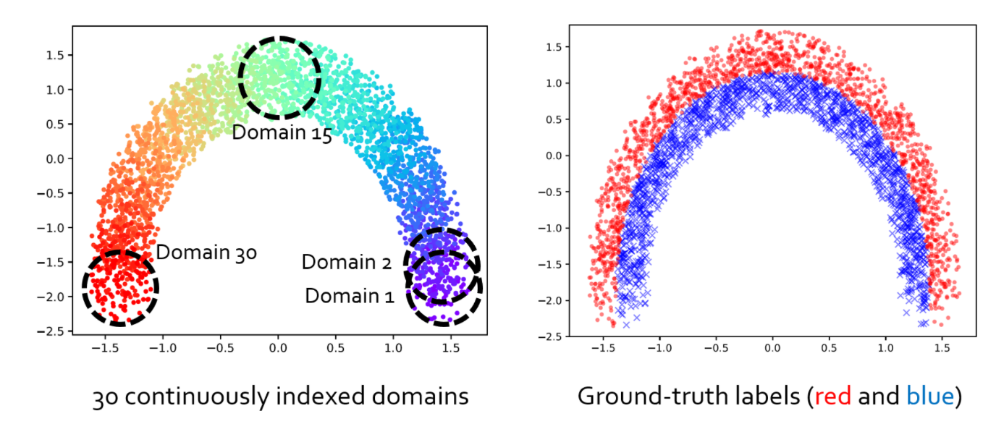
Experiment
Performance of VDI
Domain Index Visualization
Circle 30:
https://www.youtube.com/watch?v=KtZPSCD-WhQ
Notes:
Our experiments support our statements. On dataset DG-15, our model has a large gap with other models for at least 10 percent accuracy improvement.

Slide 47
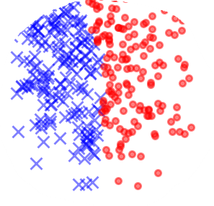
Experiment
Performance of VDI
Domain Index Visualization
Circle 30:
Notes:
Our experiments support our statements. On dataset DG-15, our model has a large gap with other models for at least 10 percent accuracy improvement.

Slide 48
Experiment
Performance of VDI
Domain Index Visualization
Circle 30:
6°
Notes:
Our experiments support our statements. On dataset DG-15, our model has a large gap with other models for at least 10 percent accuracy improvement.

Slide 49
Experiment
Performance of VDI
Domain Index Visualization
Circle 30:
……
6°
6°
Notes:
Our experiments support our statements. On dataset DG-15, our model has a large gap with other models for at least 10 percent accuracy improvement.

Slide 50
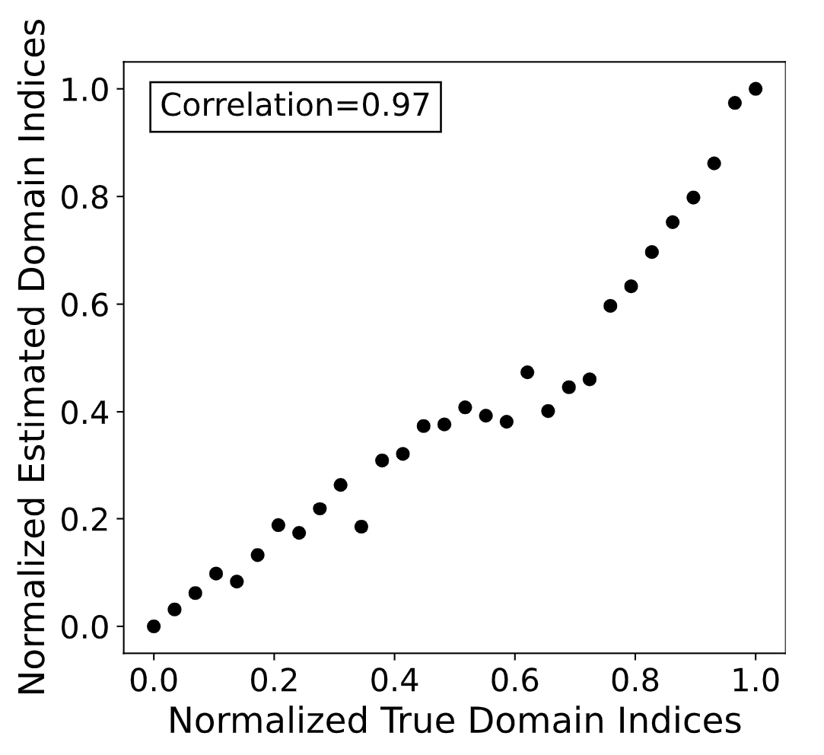
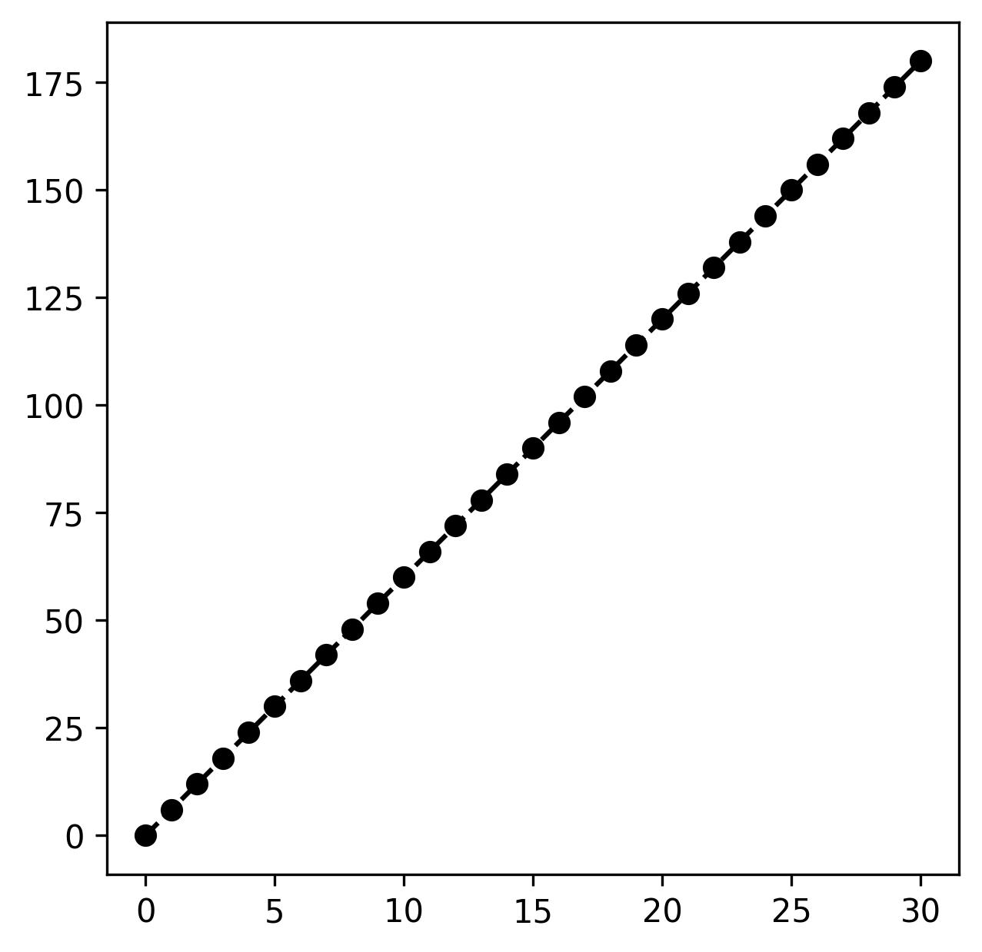
Experiment
Performance of VDI
Domain Index Visualization
Ground truth domain index: continuous rotation degree
Inferred domain index
Correlation: 0.97
Notes:
Verify hypothesis

Slide 51
Experiment
Performance of VDI
Domain Index Visualization
CompCars:
Task: Car Type Classification
Domain: View-Year of Manufacture (YOM)
View: Rear-Side, Year: 2011, Car Type: Sedan
Notes:
Our experiments support our statements. On dataset DG-15, our model has a large gap with other models for at least 10 percent accuracy improvement.

Slide 52
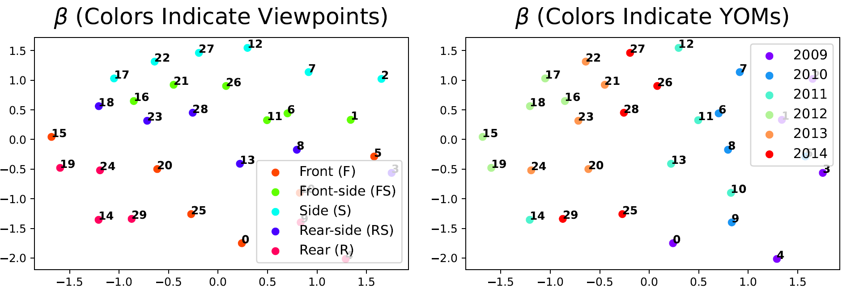
Experiment
Performance of VDI
Domain Index Visualization
Notes:
Our experiments support our statements. On dataset DG-15, our model has a large gap with other models for at least 10 percent accuracy improvement.

Slide 53
Experiment
Performance of VDI
Domain Index Visualization
Notes:
Every time you show a animation, show a image, two close one and 2 far away one.

Slide 54
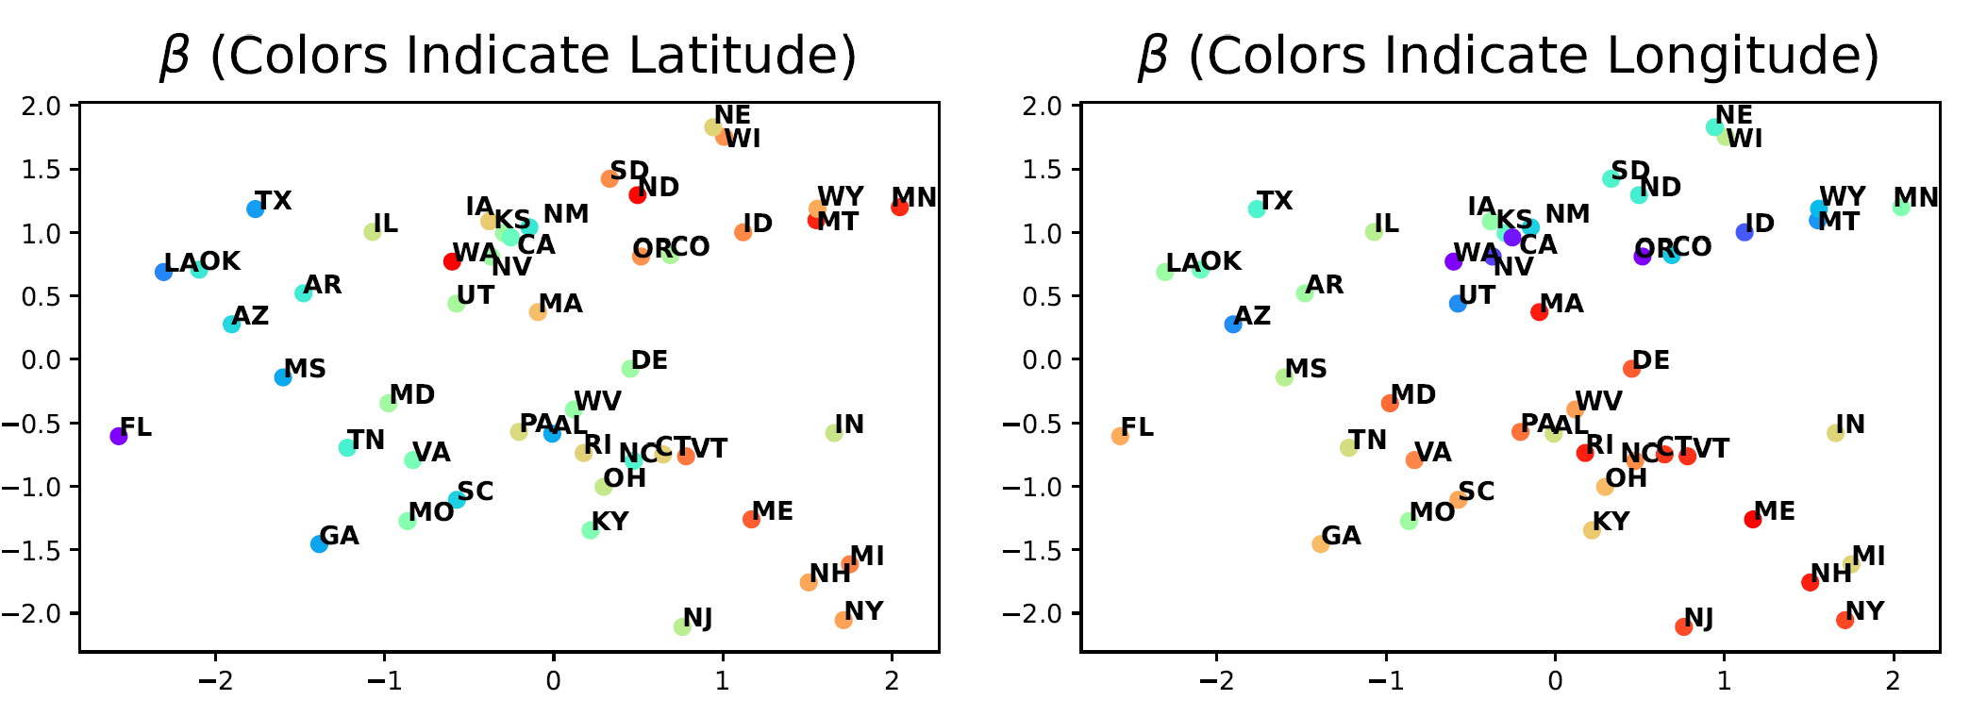
Experiment
Performance of VDI
Domain Index Visualization
TPT-48:
Notes:
NJ New jersey close to NY, focus on one, delete another (same for compcars). Adding spectrum of latitude and longtitude.

Slide 55
Experiment
Performance of VDI
Toy Dataset result:
Notes:
Our experiments support our statements. On dataset DG-15, our model has a large gap with other models for at least 10 percent accuracy improvement.

Slide 56
Experiment
Performance of VDI
Real Dataset result:
Notes:
Our experiments support our statements. On dataset DG-15, our model has a large gap with other models for at least 10 percent accuracy improvement.

Slide 57
Method
Intuition behind local/global domain indices
Infer
Aggregate
Age: 24.7
Age: 25.4
Average Age: 25.0
Age: 25.1
Age: 24.8
Local Domain Index (One per data)
Global Domain Index (One per domain)
Notes:
反过来的方向，beta -> u -> x

